Slide 1

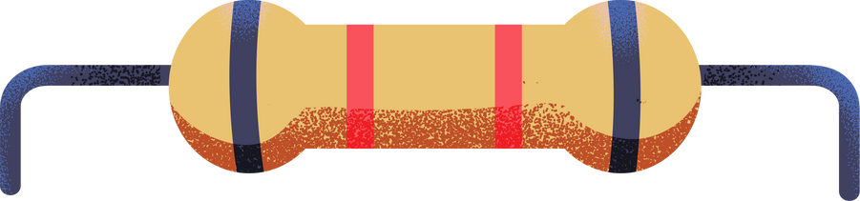
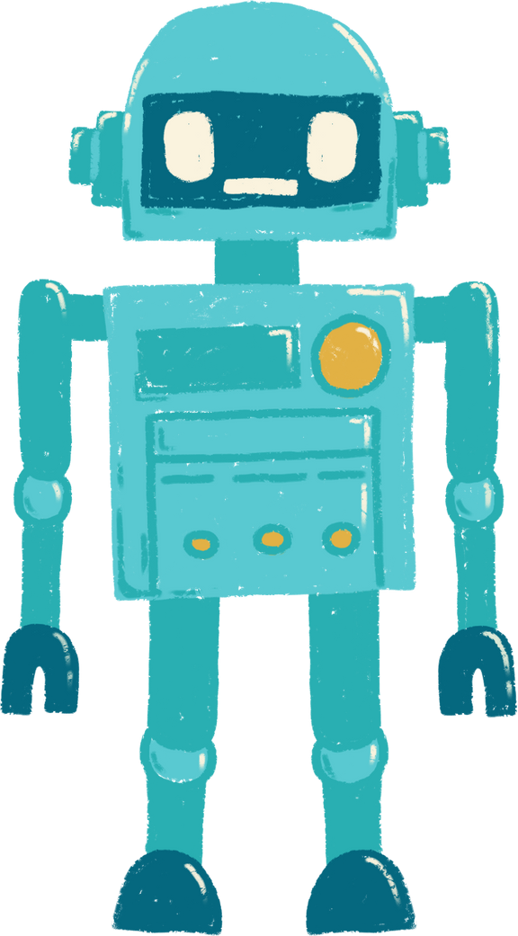


Chatbot Design and Tuning
Avaya

Slide 2



Table Of Contents
1
2
3
UX Design
IVR Tuning
Conclusion
Chatbot redesign for internal system
Tuning IVR systems for better usability
Elaborate on what you
want to discuss.

Slide 3


1
UX Design
Internal Service Chatbot Redesign

Slide 4




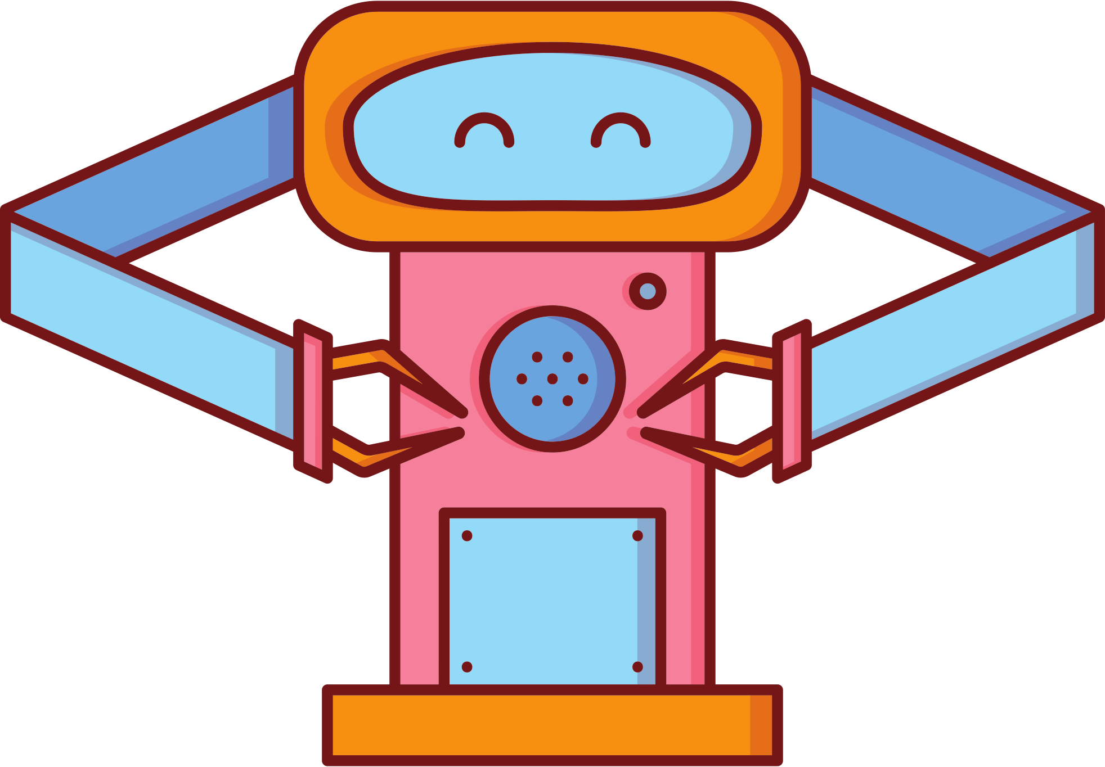





Chatbot Redesign
Avaya had an internal chatbot for customers. The old design had the following issues:
Redundant use cases
Outdated use cases that provide inaccurate product information
There were new use cases that also had to be included in the chatbot

Slide 5
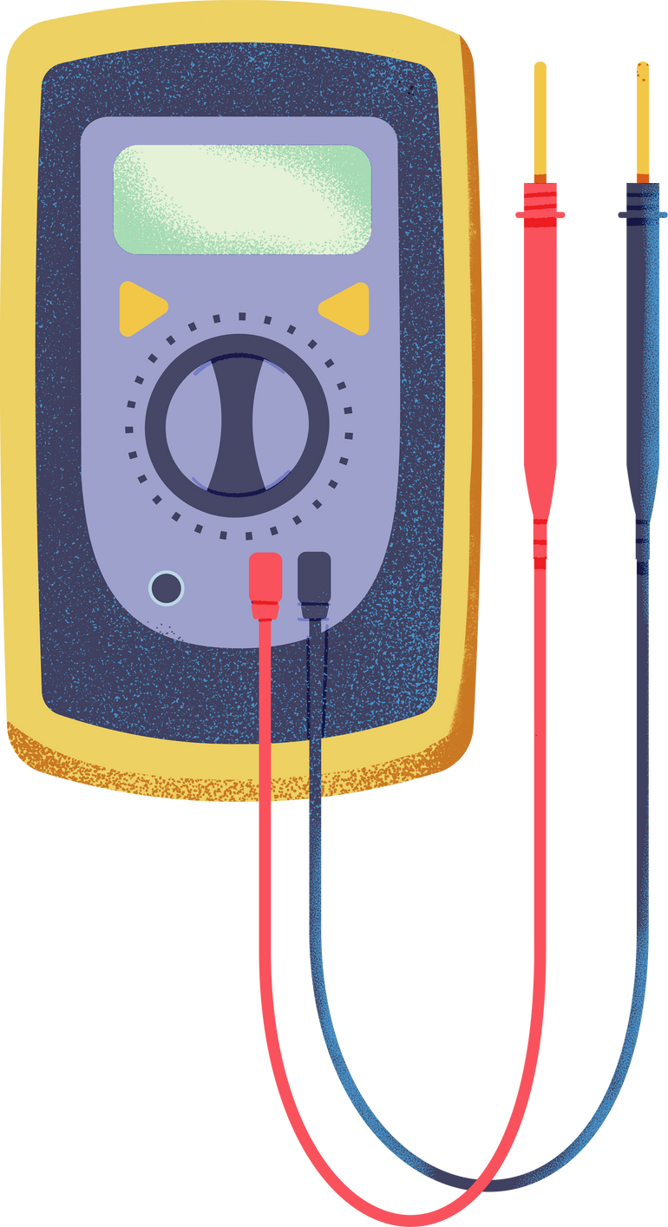

UX Design Process
Analyzed current design
Use Case Creation
Review Use Case Designs
Review current chatbot’s use cases and discussed with stakeholders on what needs to be kept
Replicated and created new use cases for Global Services Chatbot
Reviewed use case design with supervisor to determine next steps

Slide 6

Design Timeline
Stakeholder Discussion
Created new use cases
Created new use cases based on stakeholder requirements. Created conversation paths, options, etc
Discussed with stakeholders on which use cases to keep
Compare Use Cases
Review use cases
Compare Avaya Cloud Services and my bot for any similarities and replicated use cases
Collaborate with manager to review use cases

Slide 7
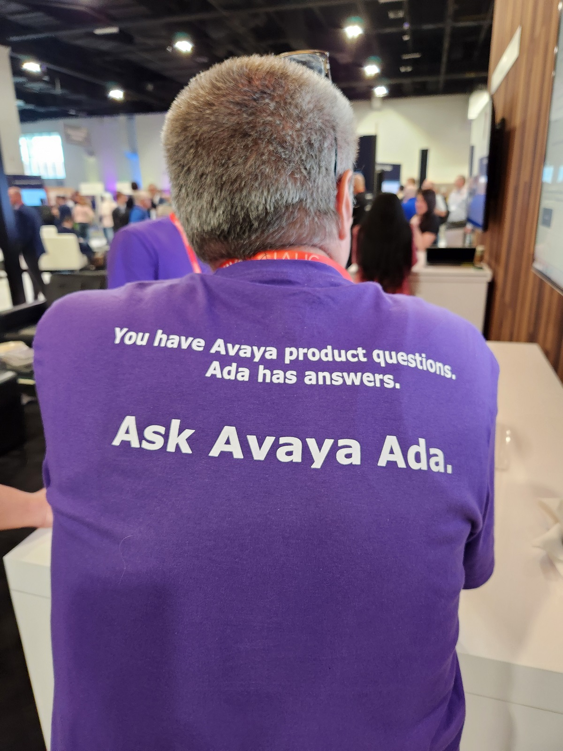


Generative AI
Worked to figure out how to integrate Avaya’s generative AI with current GSS chatbot for use cases that couldn’t be covered.

Slide 8
2
IVR Tuning
Analyzing transcripts of data and finding which words were recognized by the IVR system

Slide 9
What is it?
Avaya had worked with many clients across many industries. I helped by checking systems by checking transcripts. In some cases, I provided recommendations for grammar/usability improvements

Slide 10
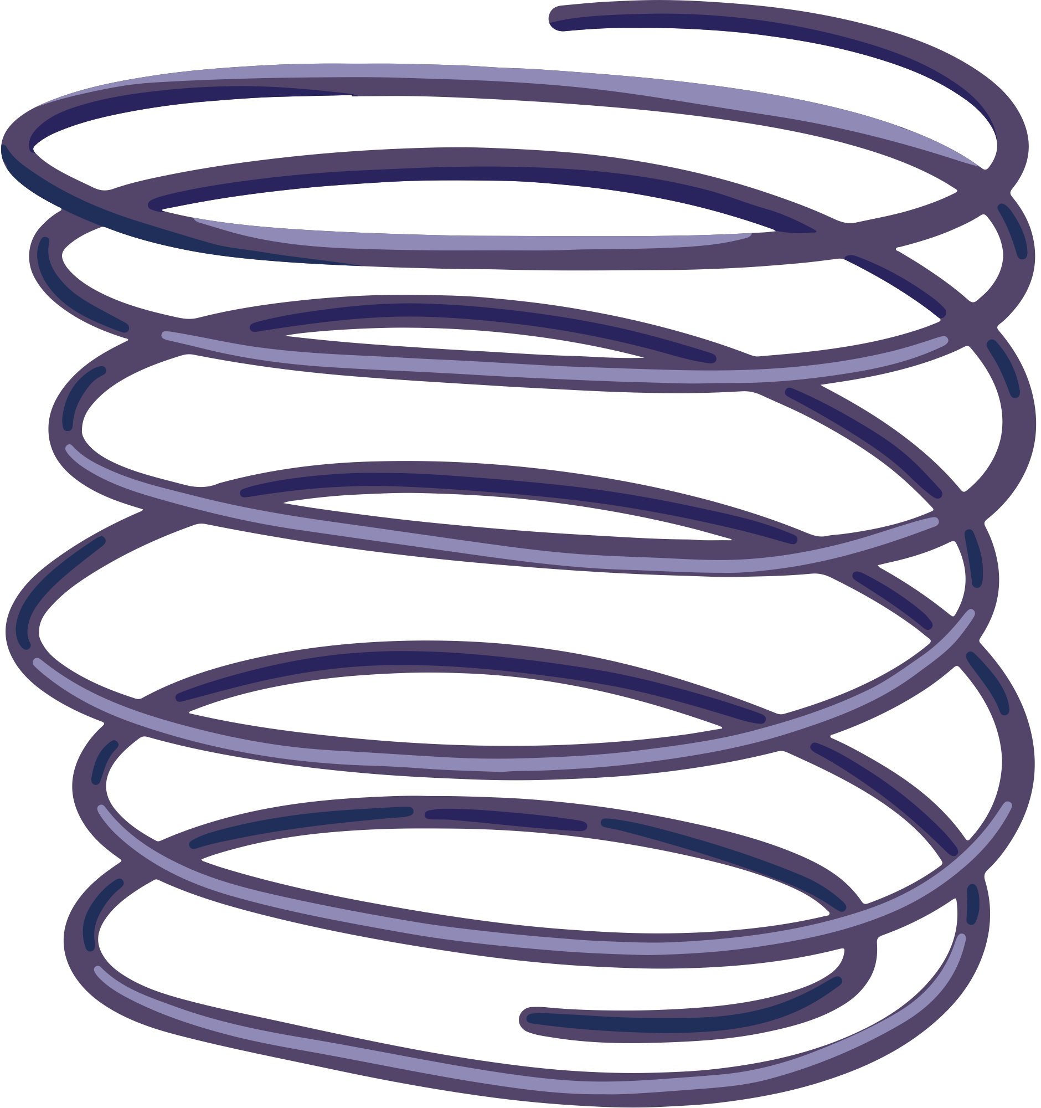


Projects
International Utilities Company
Tested French and English street names to understand recognition rate. Found an increased pass rate after testing
Airlines
Analyzed transcripts for crew and passengers and provided usability recommendations for grammar recognition. Found system misidentified different utterances that weren’t present
.

Slide 11

My time at Avaya taught me how to work with different clients with different needs. Overall, I’m thankful for my time.

Slide 12


Thank you!
Thank you for your time!

